Slide 1



PROJECT
"PREDICTING THE CITY-CYCLE FUEL CONSUMPTION IN MILES PER GALLON OF A CAR"
A CLASSIFICATION PROBLEM​
February 2025
Presented by:
Team 5

Slide 2

PROJECT OVERVIEW
Goal: Create a POC for a ML service that predicts city-cycle MPG, aiding car rental fleet decisions. Using the Auto MPG Dataset (406 records), we developed a classification model to group vehicles by fuel efficiency
What’s Coming Up:
Exploratory Data Analysis (EDA): Understanding the dataset and uncovering key insights.
Data Preprocessing: Preparing the data for modeling.
Model Development: Building, training, and evaluating a classification model.
Results & Insights: Presenting the model’s performance and its alignment with historical trends.
Problem Statement:
Car rental companies face the challenge of optimizing their fleet's fuel efficiency to reduce costs and meet environmental standards. Our task was to transform a regression problem into a classification model that predicts whether a vehicle falls into low, medium, or high fuel efficiency categories based on eight key attributes including weight, horsepower, and model year.

Slide 3


Slide 4

Dataset overview
The Auto MPG dataset contains 406 vehicle records with 9 features
Key attributes analyzed:
MPG (Miles Per Gallon): The target variable, ranges from 9 to 46.6 MPG
Weight: Ranging from 1,613 to 5,140 pounds
Horsepower: Ranging from 46 to 230 HP
Model Year: Spans from 1970 to 1982, reflects technological advancements over time.
Other important features: Cylinders, Displacement, Acceleration, Origin

Slide 5
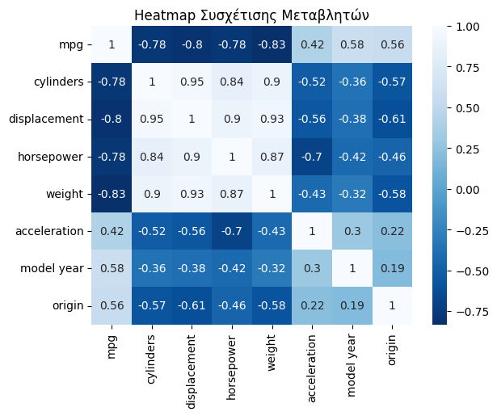
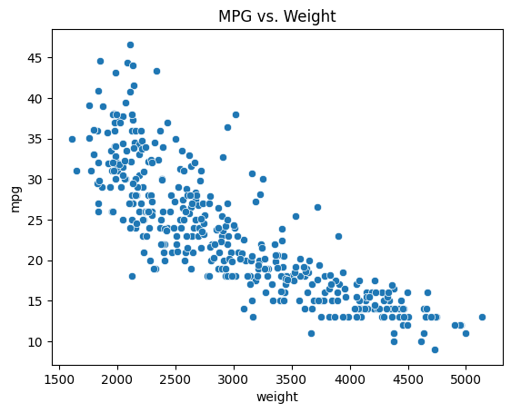
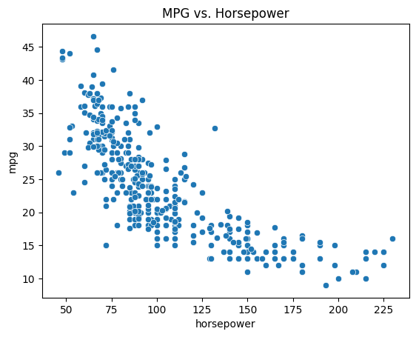
Data Relationships
Correlation heatmap of variables
The heatmap reveals several strong correlations:
MPG has strong negative correlations with:
Weight (-0.83): Heavier cars consume more fuel
Displacement (-0.8): Larger engines use more fuel
Horsepower (-0.78): More powerful engines consume more fuel
Model year shows a positive correlation (0.58) with MPG, indicating improved fuel efficiency over time.
Origin has a moderate positive correlation (0.57) with MPG, suggesting regional differences in fuel efficiency
mpg vs. weight: Demonstrate how fuel efficiency decreases as weight increases.
mpg vs. horsepower: Show the trend of lower mpg for higher horsepower.

Slide 6
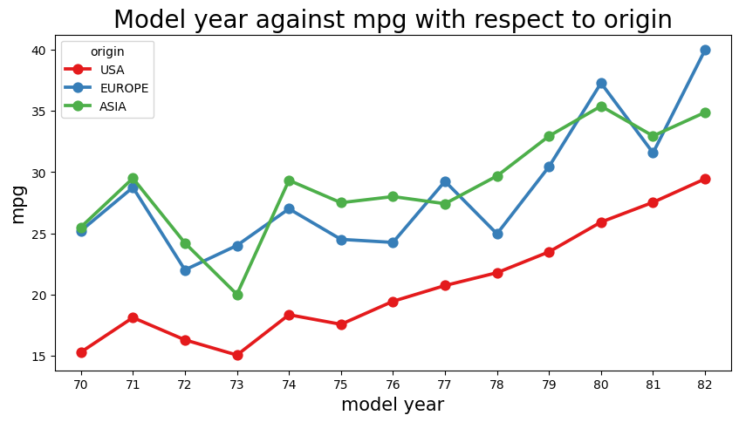
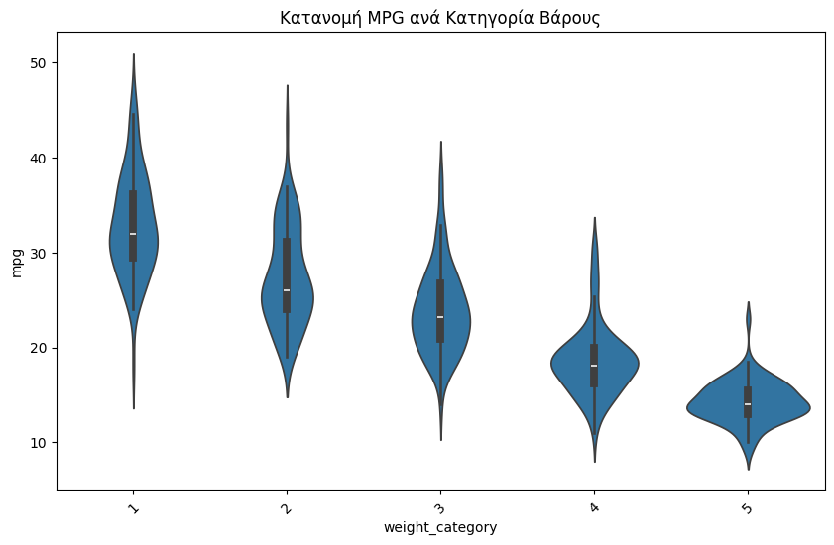
Key Insights from Data
Temporal Trends:
Clear upward trend in fuel efficiency from 1970 to 1982. Our model accurately predicts that cars from the late 1970s have lower fuel efficiency compared to modern vehicles. Average MPG improved from ~15 MPG in 1970 to ~27 MPG in 1982
Weight-MPG Relationship
Weight-MPG Relationship:
Strong inverse relationship between vehicle weight and fuel efficiency
Lighter vehicles consistently achieve better fuel economy
Most vehicles weighing under 2,500 lbs achieve over 25 MPG
Notes:
Temporal Trends:
Η εξέλιξη της κατανάλωσης στον χρόνο: φαίνεται ότι όσο περνάνε τα χρόνια υπάρχει μια αυξητική τάση στην μέση τιμή του mpg, αυτό οφείλεται στις νέες τεχνολογίες και στην προσπάθεια για οικονομία καυσίμων λόγω περιβαλλοντικών και οικονομικών λόγων.

Slide 7
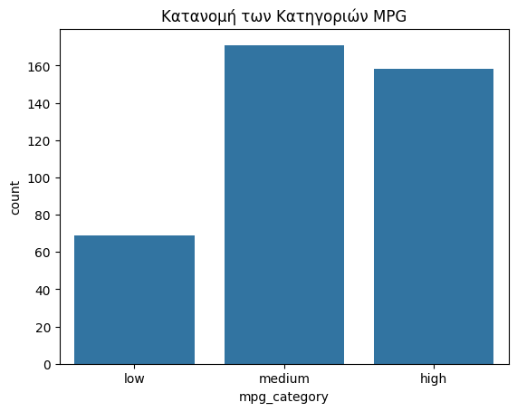


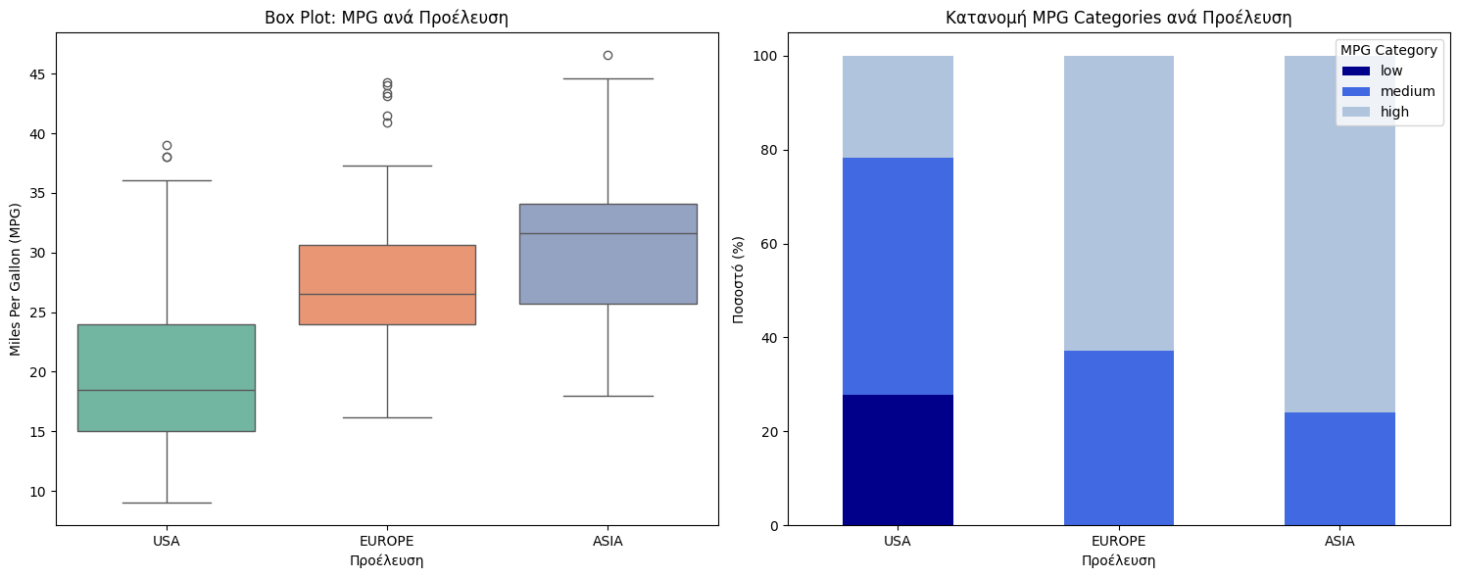
Key Insights from Data
MPG Distribution
Classification Implications:
Natural clustering appears in the data, supporting the decision to convert to a classification problem
The distribution of MPG values suggests three distinct efficiency classes:
Low efficiency: <= 15 MPG (69 vehicles, 13% of the total sample)
Medium efficiency: 16-25 MPG (171 vehicles, 44% of the total sample)
High efficiency: > 25 MPG (158 vehicles, 42% of the total sample)
Distribution of MPG Categories by Origin
Regional Differences:
Origin (1: American, 2: European, 3: Asian) shows distinct patterns
European and Asian vehicles tend to have higher fuel efficiency
American vehicles show more variance in fuel efficiency

Slide 8
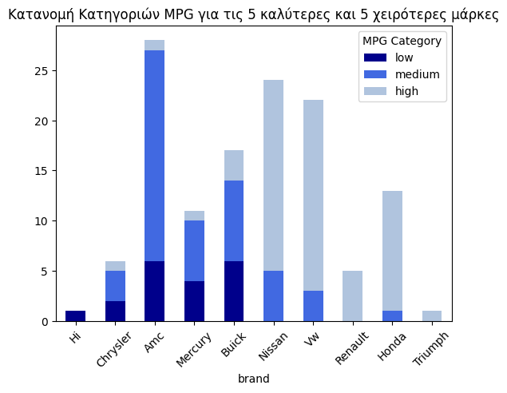
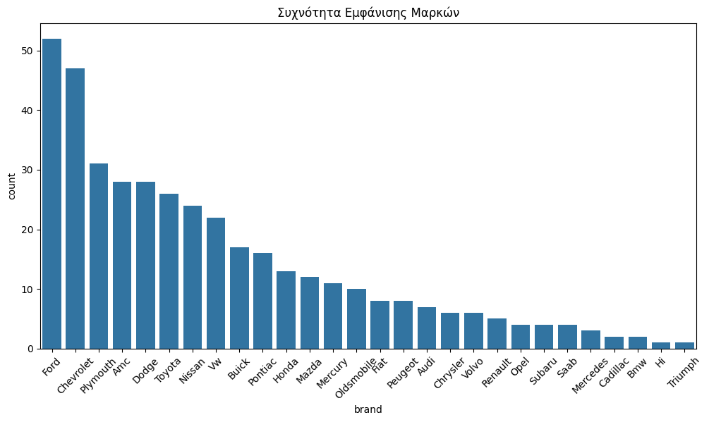
Key Insights from Data
Brand Classification :
Japanese brands (Toyota, Honda, and Volkswagen) lead in efficiency
American brands (Ford, Chevrolet, Dodge) show wider MPG variation
European brands fall in middle range
Car Brand occurrence frequency
MPG category breakdown for the 5 worst and 5 best car brands
Notes:
Top 5 μάρκες με το υψηλότερο μέσο MPG: brand Nissan 31.32 Vw 31.84 Renault 32.88 Honda 33.76 Triumph 35.00
Bottom 5 μάρκες με το χαμηλότερο μέσο MPG: brand Hi 9.00 Chrysler 17.27 Amc 18.25 Mercury 19.12 Buick 19.18

Slide 9
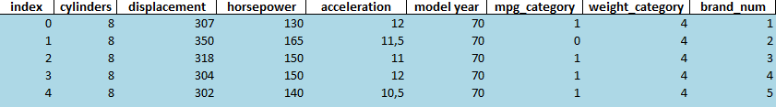
Preprocessing
Remove unnamed empty columns
Identify and handle outliers in each variable
Mpg category & weight category
Analyze correlations
Handle missing values
Create a new column: "Brand"
Preprocessing table:
post-processing table:

Slide 10

Model Development & Evaluation
Objective & Methodology
Key Results
Objective:
Goal: Compare classifiers after applying SMOTE for class balancing.
Key Focus: Evaluate models on accuracy, precision, recall, and F1 scores.
Model | Accuracy | Precision (Macro) | Recall (Macro) | F1 (Macro) | F1 (Weighted) | F1 (Class 0) | F1 (Class 1) | F1 (Class 2)
Logistic Regression | 81.79% | 81.60% | 82.37% | 81.31% | 81.59% | 79.37% | 77.72% | 86.84%
Decision Tree | 78.01% | 79.04% | 78.11% | 78.30% | 78.02% | 78.96% | 75.03% | 80.91%
Random Forest | 84.61% | 85.75% | 85.63% | 84.91% | 84.38% | 86.65% | 81.09% | 86.99%
SVM | 83.67% | 83.80% | 84.58% | 83.61% | 83.50% | 83.45% | 79.89% | 87.49%
KNN | 81.45% | 82.69% | 83.49% | 82.03% | 81.00% | 85.72% | 76.04% | 84.32%
Methodology:
Data: 80% train, 20% test, with StratifiedKFold for balanced class splits.
Preprocessing:
StandardScaler for scaling features.
SMOTE for class balancing.
Classifiers:
Logistic Regression, Decision Tree, Random Forest, SVM, KNN
Cross-validation: 5-fold cross-validation for performance evaluation.
Best Accuracy: Random Forest (84.61%)
Best F1 (Class 2): SVM (87.49%)
Best Precision: Random Forest (85.75%)
Best Recall: Random Forest (85.63%)
Balanced Performance: Random Forest excels in most metrics.

Slide 11
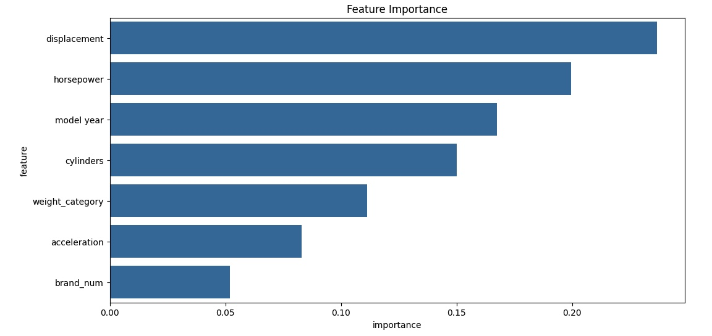
Model Development & Evaluation
Model Prediction & New Data
Model Evaluation
(Cross-Validation & Classification Report)
Steps for Prediction:
Preprocessing New Data:
Standardizing the new dataset using the same scaler that was used during training
Predictions:
Predict Classes: Using the trained model to make class predictions on the new data.
Predict Probabilities: Obtaining probabilities for each class prediction.
Class | Precision | Recall | F1-Score
0 | 0.87 | 0.93 | 0.90
1 | 0.90 | 0.79 | 0.84
2 | 0.86 | 0.94 | 0.90
Overall | 0.88 | 0.88 | 0.87
Key Insights:
Class 0: Strong performance with F1-score of 0.90.
Class 1: Performance slightly lower, but still decent with F1-score of 0.84.
Class 2: Excellent performance with an F1-score of 0.90.

Slide 12
Future Proposals
Current Data
New Technology
Fleet Optimization Strategy
Brand Selection
Brand Selection
More variables such as Location

Slide 13
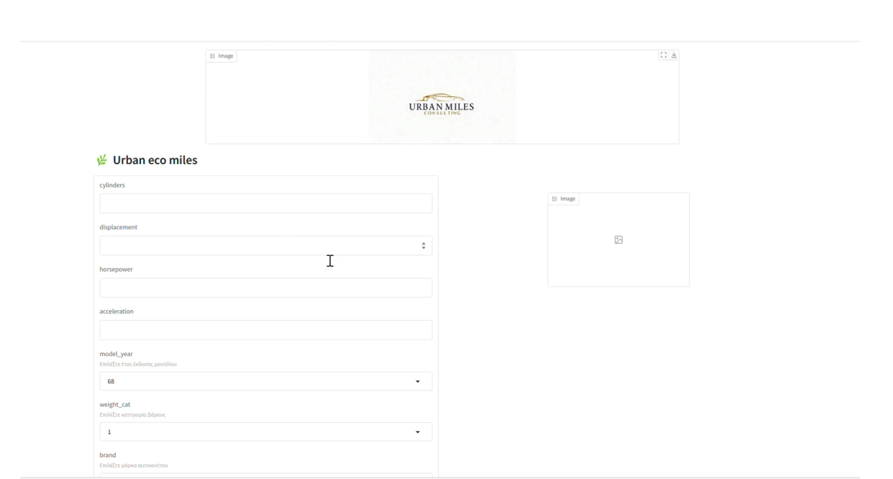

Slide 14





OUR TEAM
Patsi Dimitra
Kyriakopoulou Foteini
Mikroni Alexandra
Kakamouka Kalliopi

Slide 15


